Slide 1
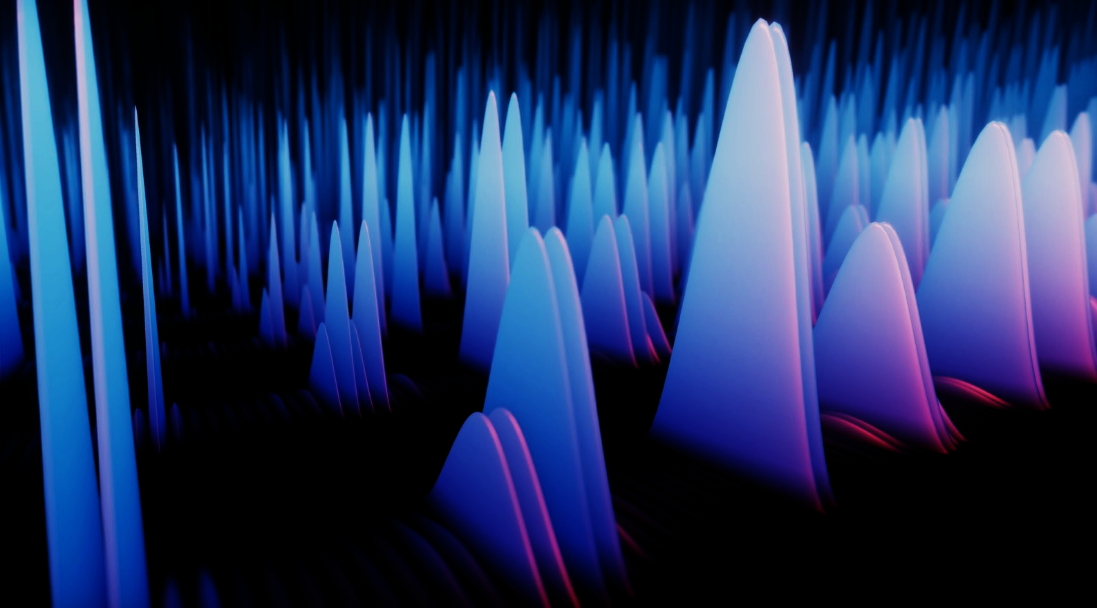

Enhancing Quantum Optimisation by leveraging their features
Vivek Katial, University of Melbourne

Slide 2
Agenda
Background on Quantum
Quantum Approximate Optimisation Algorithm (QAOA)
Design decisions
Instance Space Analysis

Slide 3
Why quantum?
Quantum Computers can theoretically solve can solve some problems much faster than classical computers
What problems?
Shors Algorithm for factoring – could break current encryption protocols
Grovers search algorithm
Simulation of physical systems – chemistry + physics
What's the catch?
Hardware is hard – assuming no errors we need several 1000s of qubits
With errors – we need millions of qubits + 100s of millions of gates

Slide 4
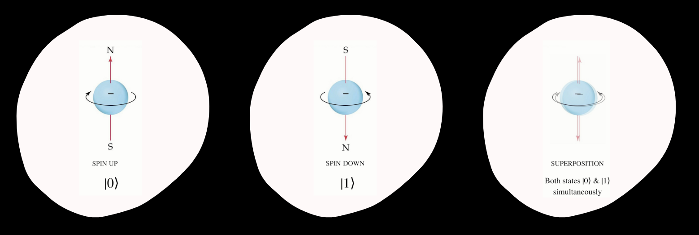
How does quantum work?

Slide 5
Measurement
Wavefunction Collapse
Probabilistic Outcome
Measurement Disturbance
When a quantum system is measured, its wavefunction collapses into a single state, and the system loses its superposition.
The outcome of a measurement is probabilistic, with the probability determined by the quantum state before the measurement.
The act of measuring a quantum system inevitably disturbs the system, making it impossible to precisely determine the pre-measurement state.

Slide 6
Noisy-intermediate scale Quantum Era
Currently we’re in the NISQ-era of Quantum Computing
Need to design algorithms that can run on NISQ-devices
Can run on small (100-1000 qubit devices)
Solve useful problems
Shouldn’t require extensive error correction
QAOA is a low-depth algorithm that can help solve optimisation problems

Slide 7
Classical vs Quantum
Proven Performance
Classical
Quantum
Heuristics
Classical
Quantum
Simplex Algorithm
Dijkstras Shortest Path
Shor’s Algorthim
Grovers unstructured search
Genetic Algorithms
Particle Swarm Optimisation
Gradient descent
QAOA
Variational Quantum Eigensolver
More being discovered…

Slide 8


Optimisation
Optimisation problems are everywhere!
These problems are hard:
Machine Learning
Vehicle Routing and Logistics Planning
Portfolio Optimisation
Social Network Analysis
Circuit Design
Max-Cut
Goal is to find $x$ to minimize a cost function $C(x)$
Possibility of a “quantum advantage” has motivated lots of interest in this field

Slide 9





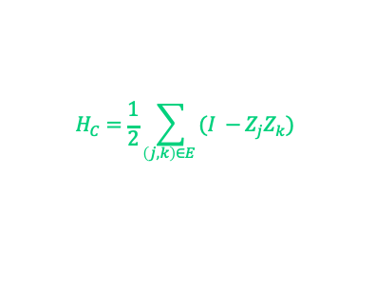
Our Approach
Step 1
Step 2
Step 3
Step 4
Step 5
Formulate Problem
Hamiltonian
Heuristic Quantum Algorithms / Circuit
Quantum Computer + Classical Loop (HPC)
Instance Space Analysis
$$H_{C}=\frac{1}{2}\sum_{\left(j, k\right)∈E }{(I −Z_{j}Z_{k})}$$
$$H_{B}=\sum_{j=1}^{n}{X_{j}}$$

Slide 10
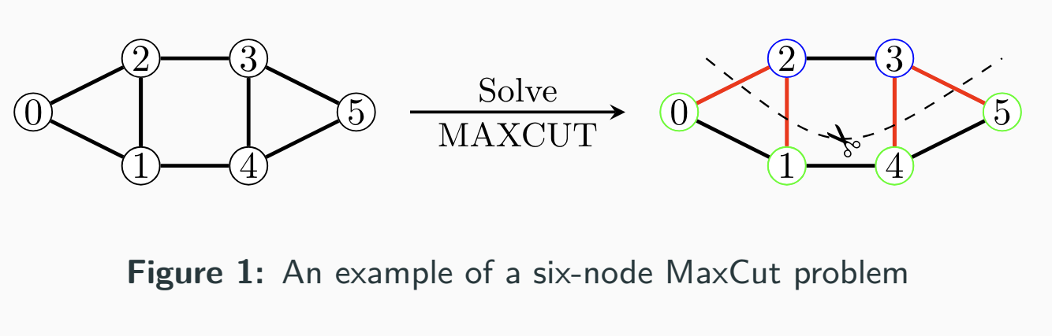


Maxcut
Partition a graph 𝐺 = (𝑉 , 𝐸) into two sets 𝑆 and 𝑉 ∖ 𝑆 such that the number of edges between the two sets is maximised.
$$\max_{x}=\sum_{x∈(i,j)}{w_{ij}(1−x_{i}x_{j})}$$
where $x_{i}$ ∈ {−1, 1} and $w_{ij}$ is the weight of edge (𝑖, 𝑗).

Slide 11

Quantum Approximate Optimization Algorithm (QAOA)
QAOA is a hybrid-quantum algorithm designed to find good approximate solutions to optimisation problems
QAOA is parameterised and relies on the setting of parameters$γ, β$
These parameters are adjusted using classical optimisation routines to minimise an objective function

Slide 12

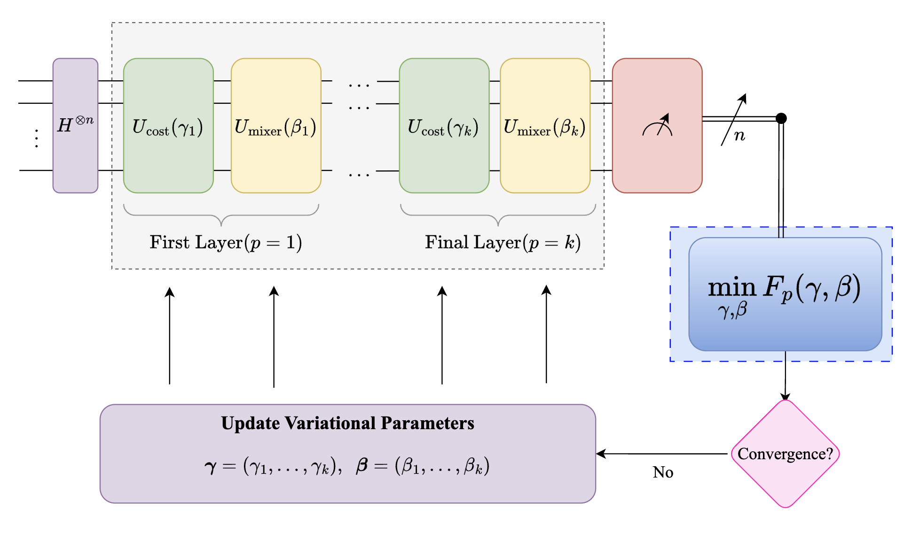

QAOA SCHEMA
There are three key decisions
Layer depth $p$
Initial settings of $γ, β$
Which Classical Optimizer?
e.g. Nelder-Mead, ADAM

Slide 13
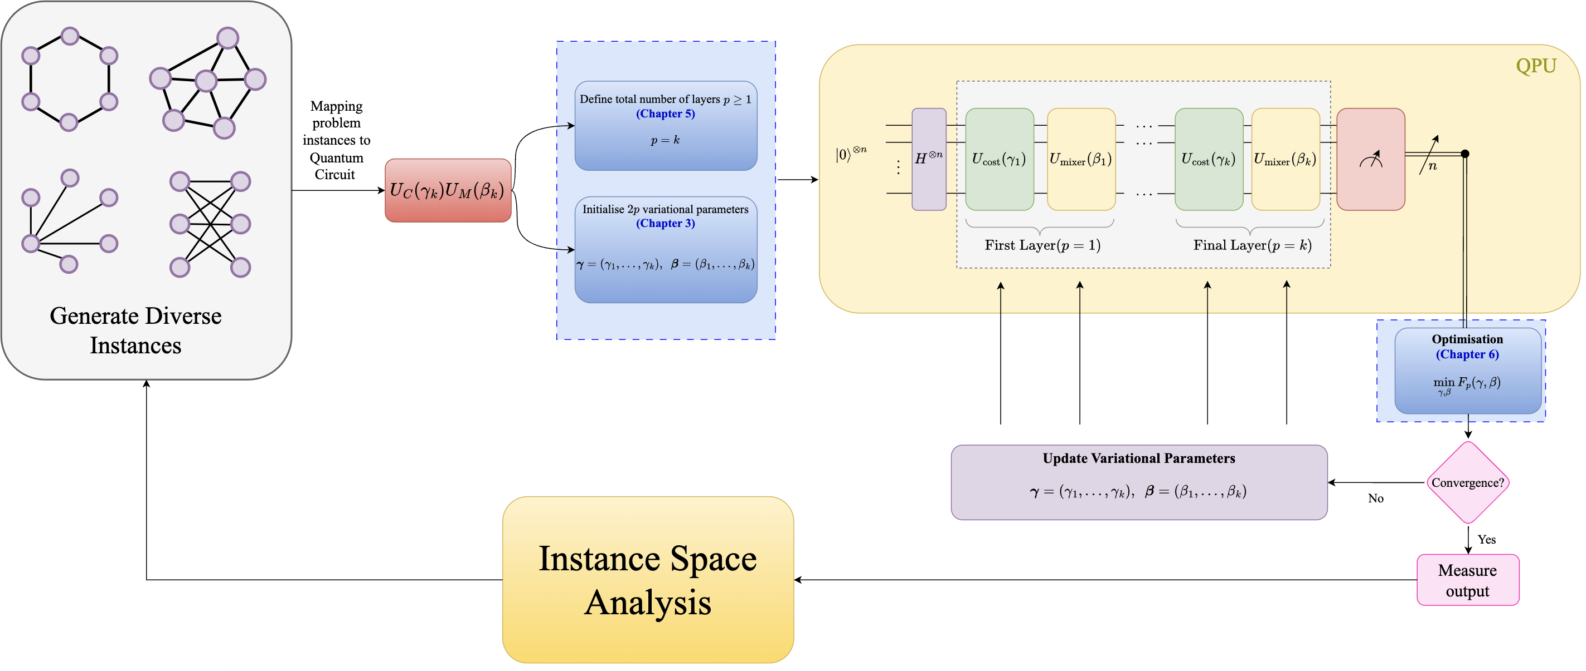
Our Approach

Slide 14


QAOA Optimisation Landscape
QAOA landscape which is given by:
$$F_{p}\left(γ, β\right)=⟨ψ_{p}(γ, β)| H | ψ_{p}\left(γ, β\right)⟩$$
Where $| ψ_{p}\left(γ, β\right)⟩$ is the quantum state.
This expectation is minimised using a classical optimisation routine.

Slide 15
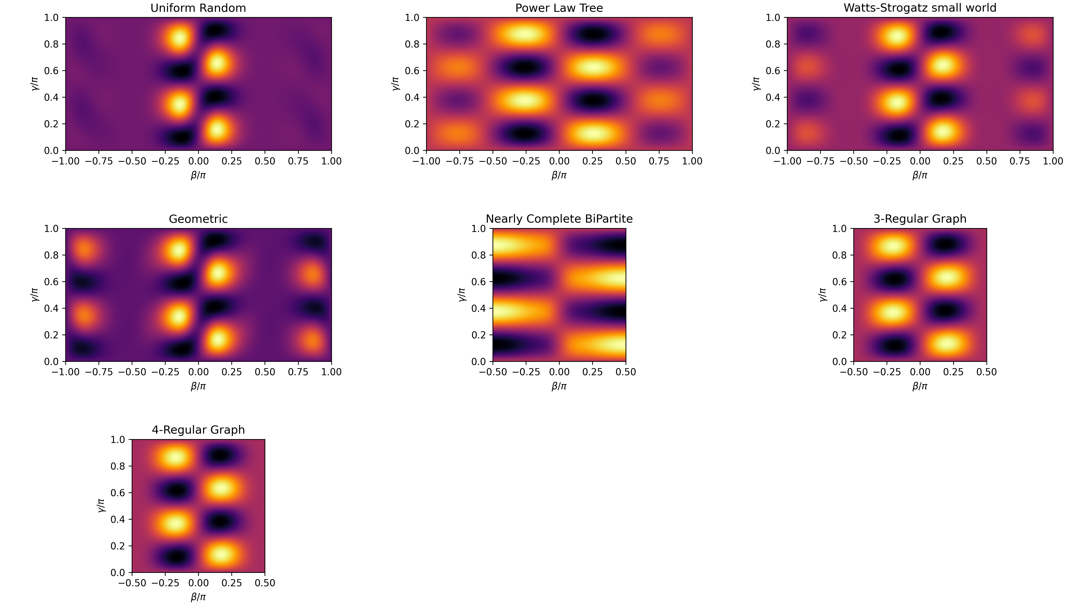
Importance of instance Diversity
Parameter Sensitivity:
Optimal parameters vary across problem instances.
High computational cost for repeated optimization.
Barren Plateaus and Rugged Landscapes:
Flat optimisation landscapes hinder finding optimal parameters
Limited Generalization:
Most studies focus on specific problem classes.
Findings may not generalize to diverse instances.
Benefits of instance-based approaches?
Reduces calls to quantum devices → less resource use

Slide 16
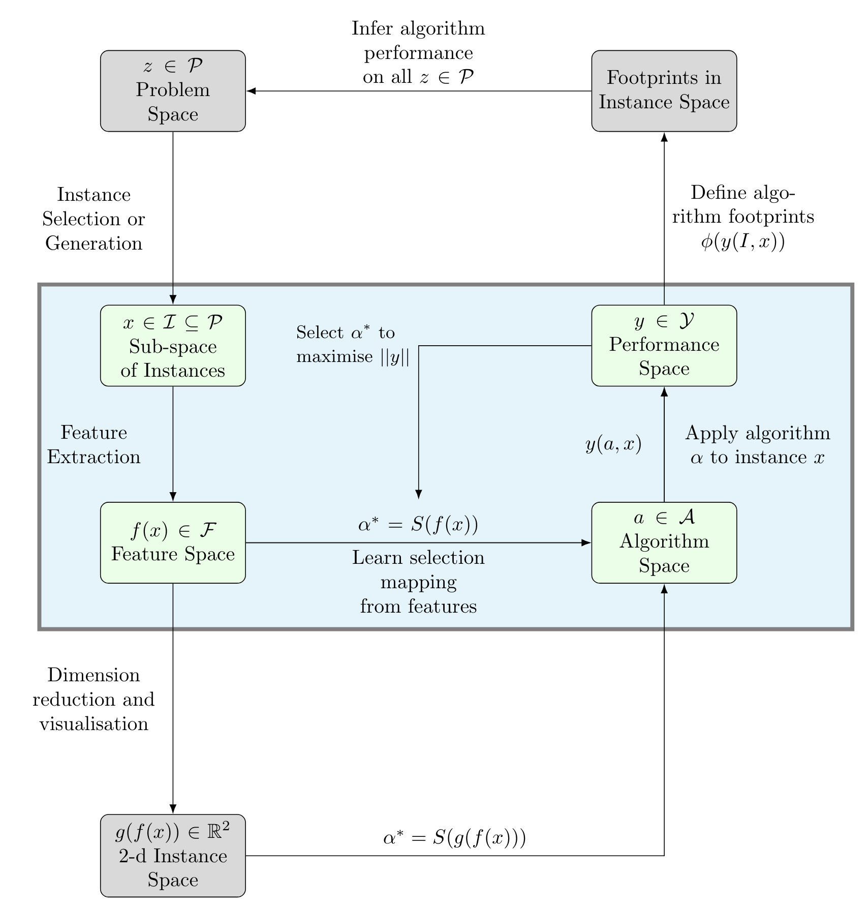
Instance Space Analysis

Slide 17
Features
Structural Features
Number of Edges
Bipartite Graph
Clique Number
Connected Graph
Density
Edge Connectivity
Maximum Degree
Minimum Degree
Minimum Dominating Set
Cycle and Path based Features
Acyclic Graph
Average Distance
Diameter
Eulerian Graph
Number of Components
Planar Graph
Radius
Weight-related Features
Mean Weight
Median Weight
Standard Deviation of Weight
Minimum Weight
Maximum Weight
Range of Weight
Skewness of Weight
Kurtosis of Weight
First Quartile of Weight
Third Quartile of Weight
Interquartile Range of Weight
Variance of Weight
Coefficient of Variation of Weight
Weighted Average Clustering
Weighted Average Shortest Path Length
Weighted Diameter
Weighted Radius
Maximum Weighted Degree
Minimum Weighted Degree
Features inspired by related work
Distance-Regular Graph
Group Size
Number of Cut Vertices
Number of Minimal Odd Cycles
Number of Orbits
Graph Entropy
Regular Graph
Smallest Eigenvalue
Vertex Connectivity
Spectral Features
Algebraic Connectivity
Laplacian Largest Eigenvalue
Ratio of Two Largest Laplacian Eigenvalues
Ratio of Two Smallest Laplacian Eigenvalues

Slide 18
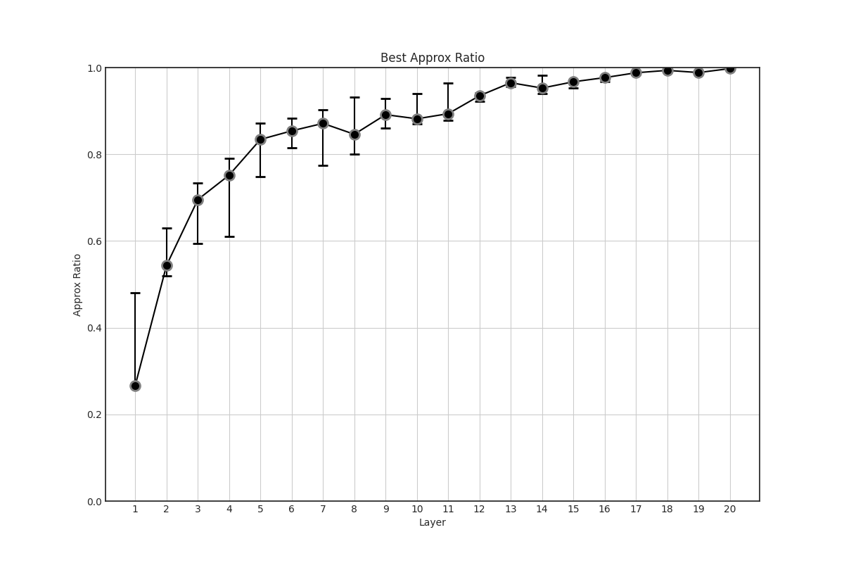
Our algorithm is Layer depth
We examine the following layer depths:
2
5
10
15
20
Performance Measure:
How many function evaluations does each algorithm take to achieve 95% of the best performance per instance

Slide 19
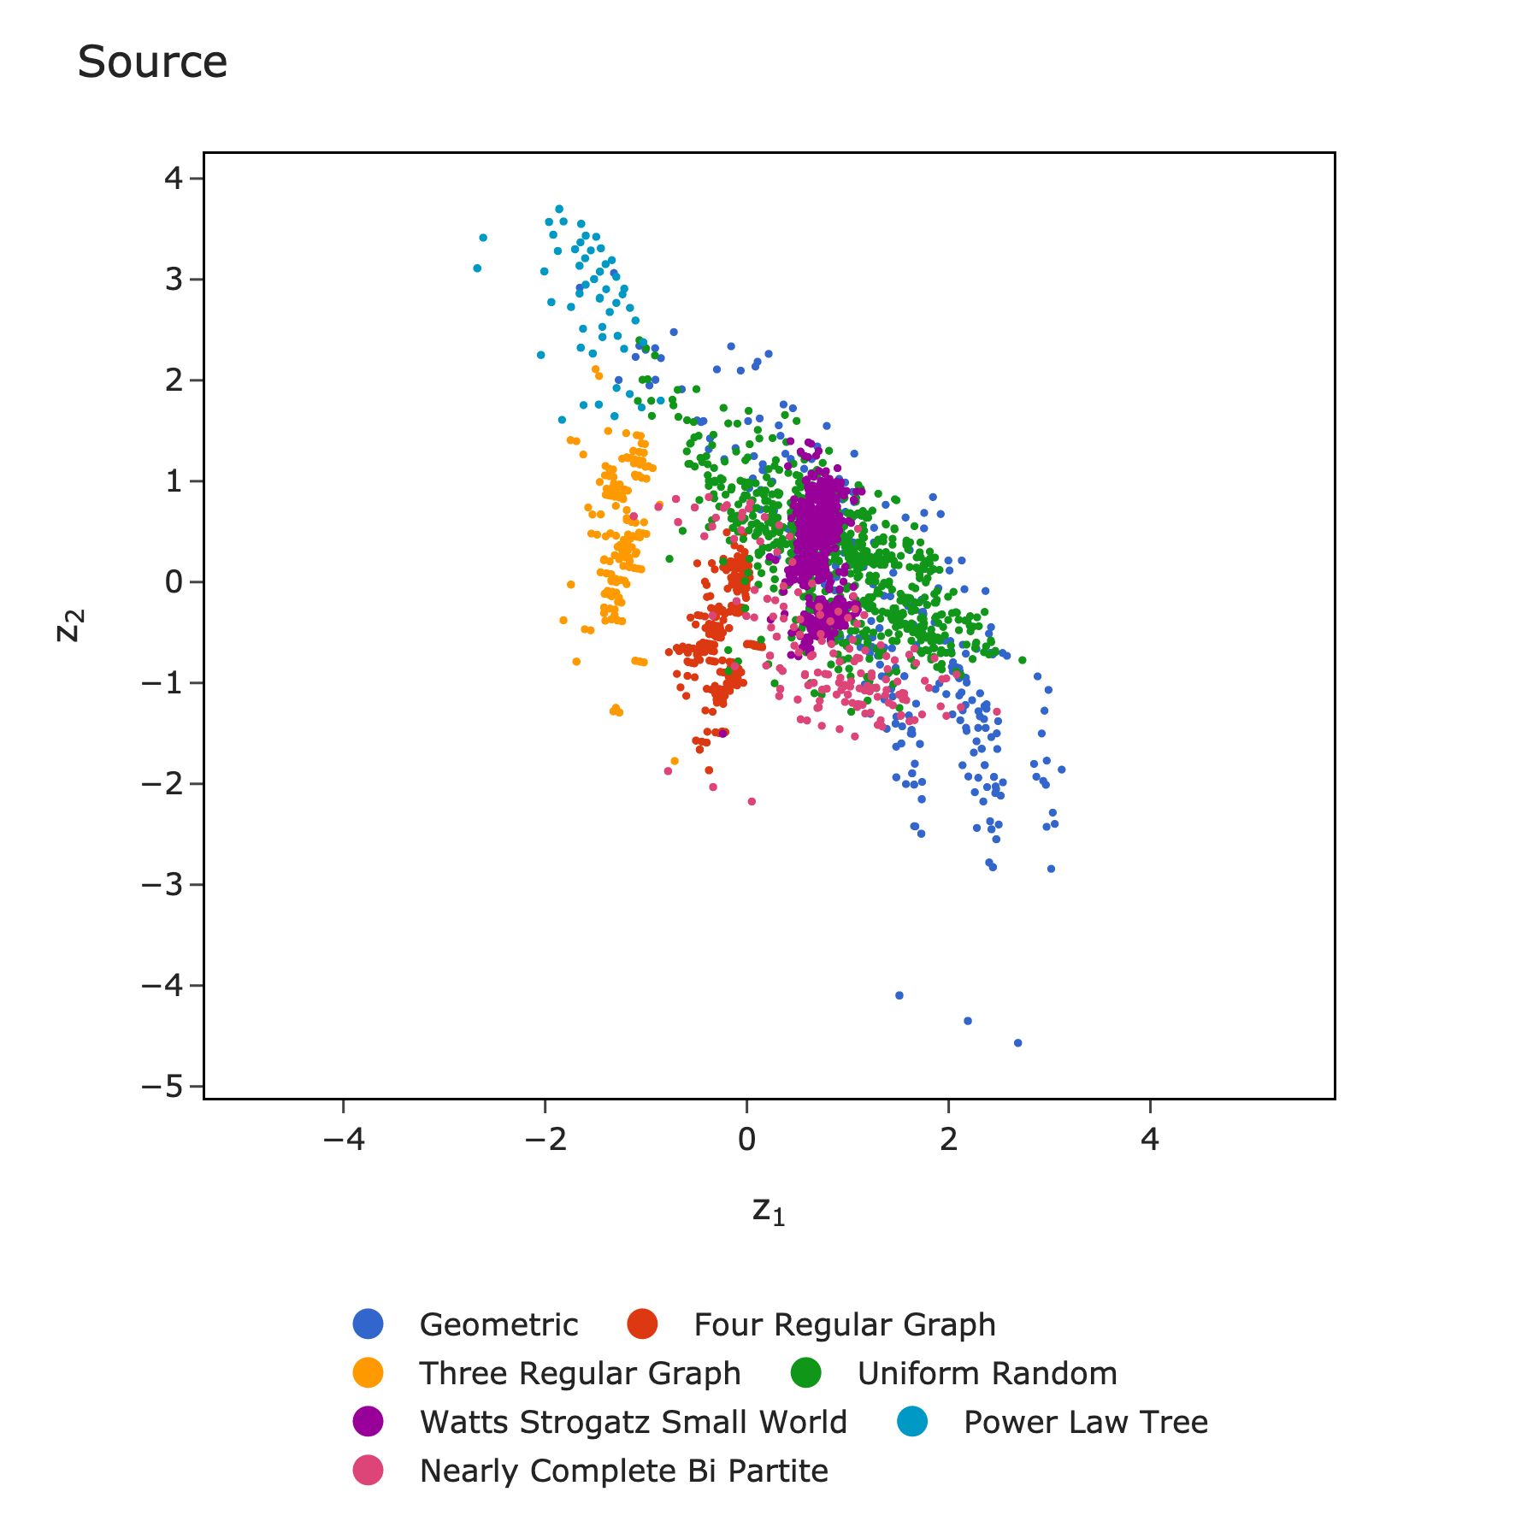
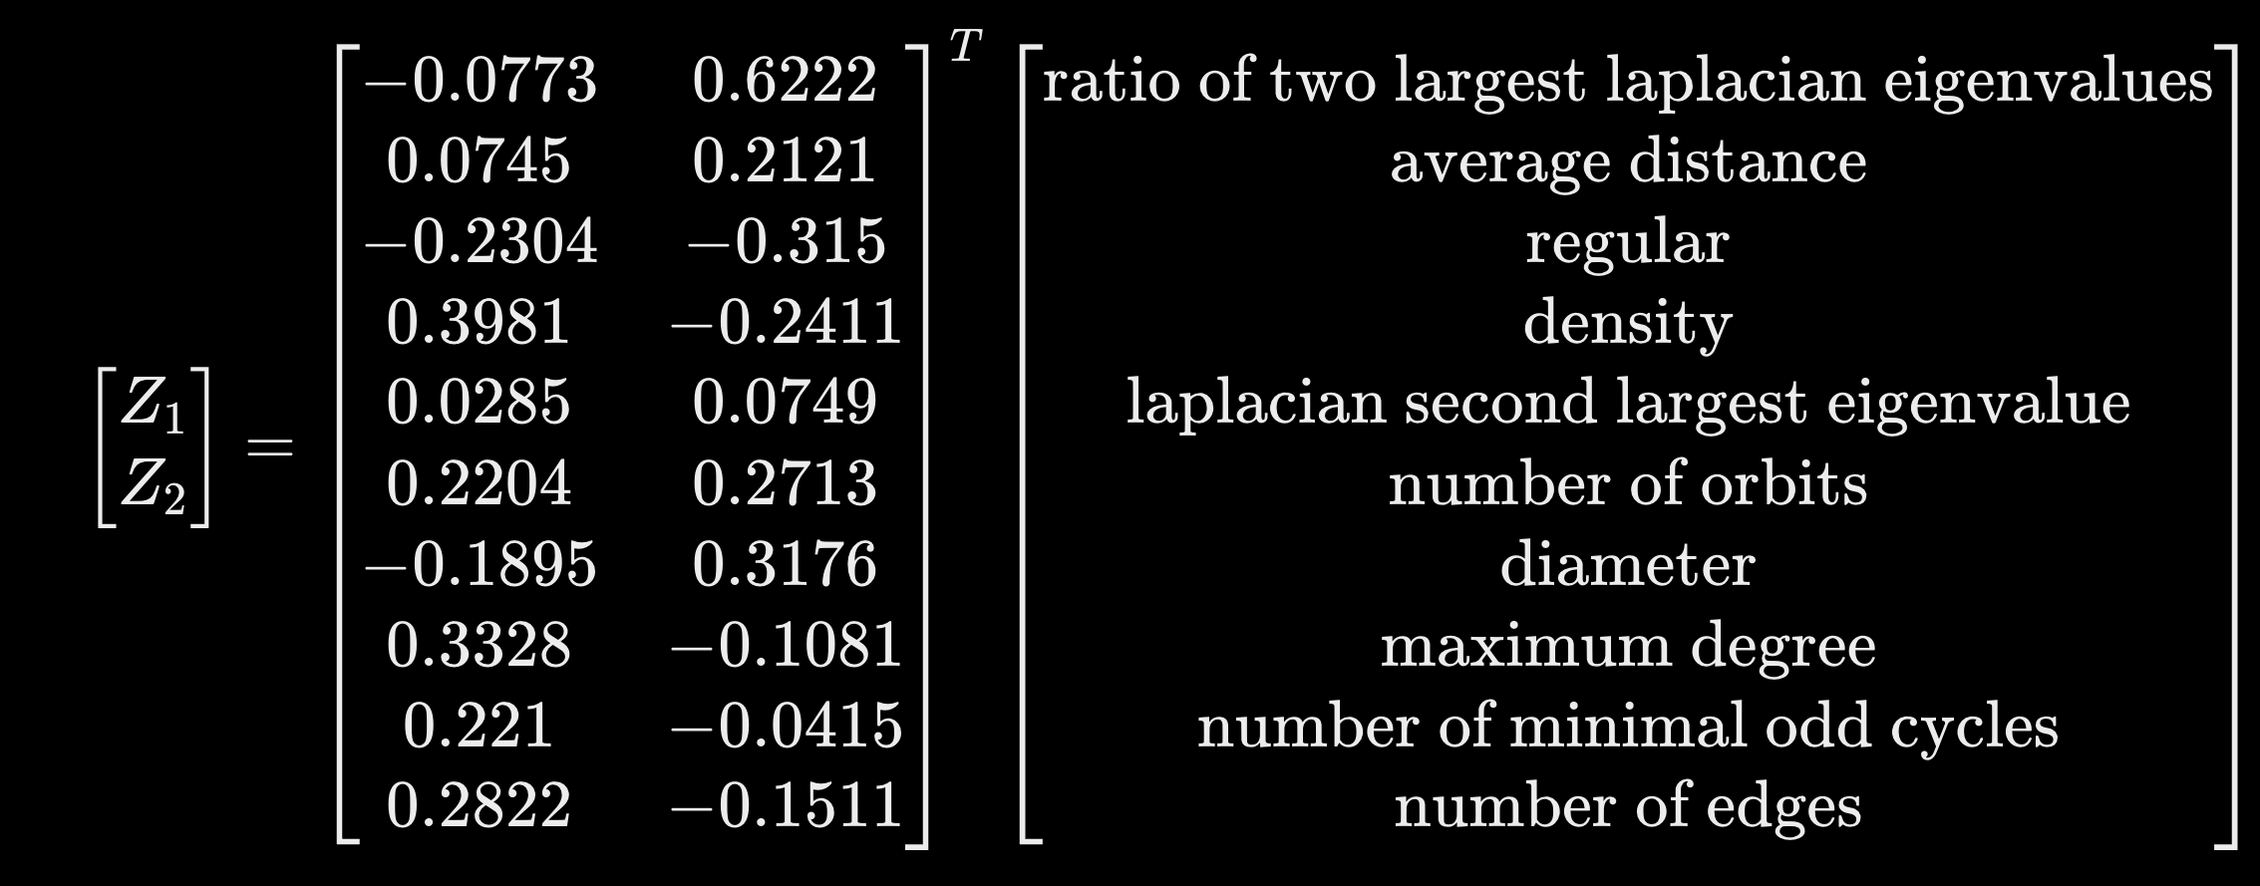
Instance space

Slide 20
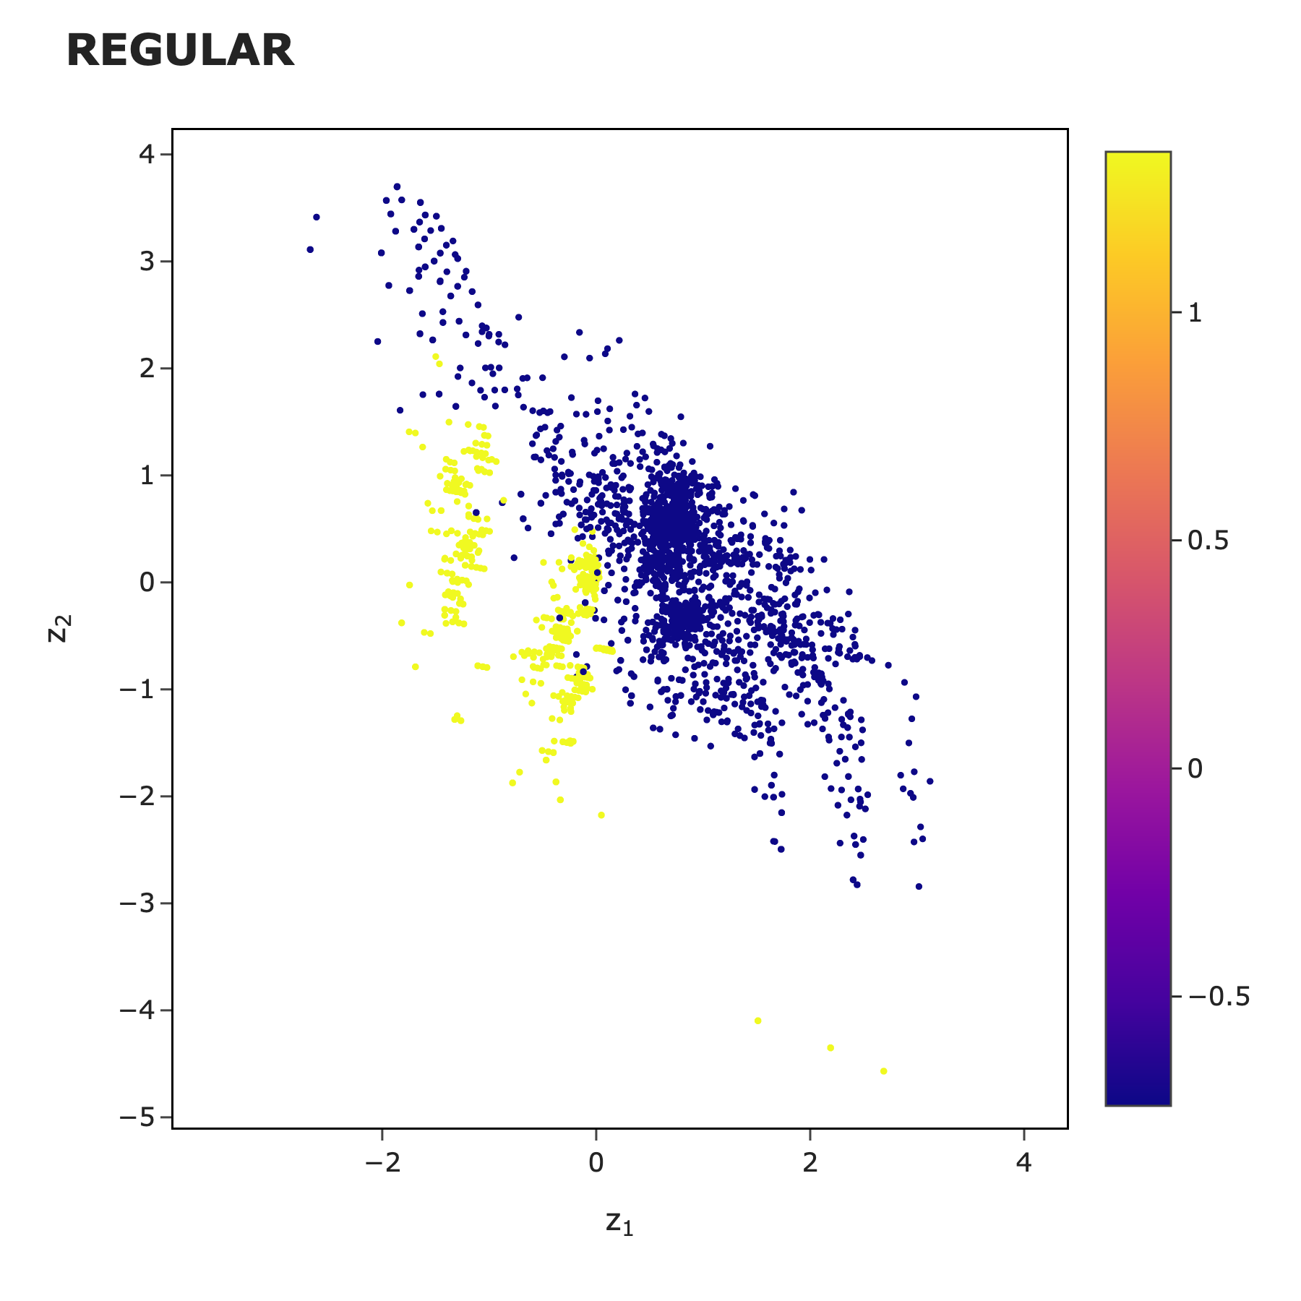
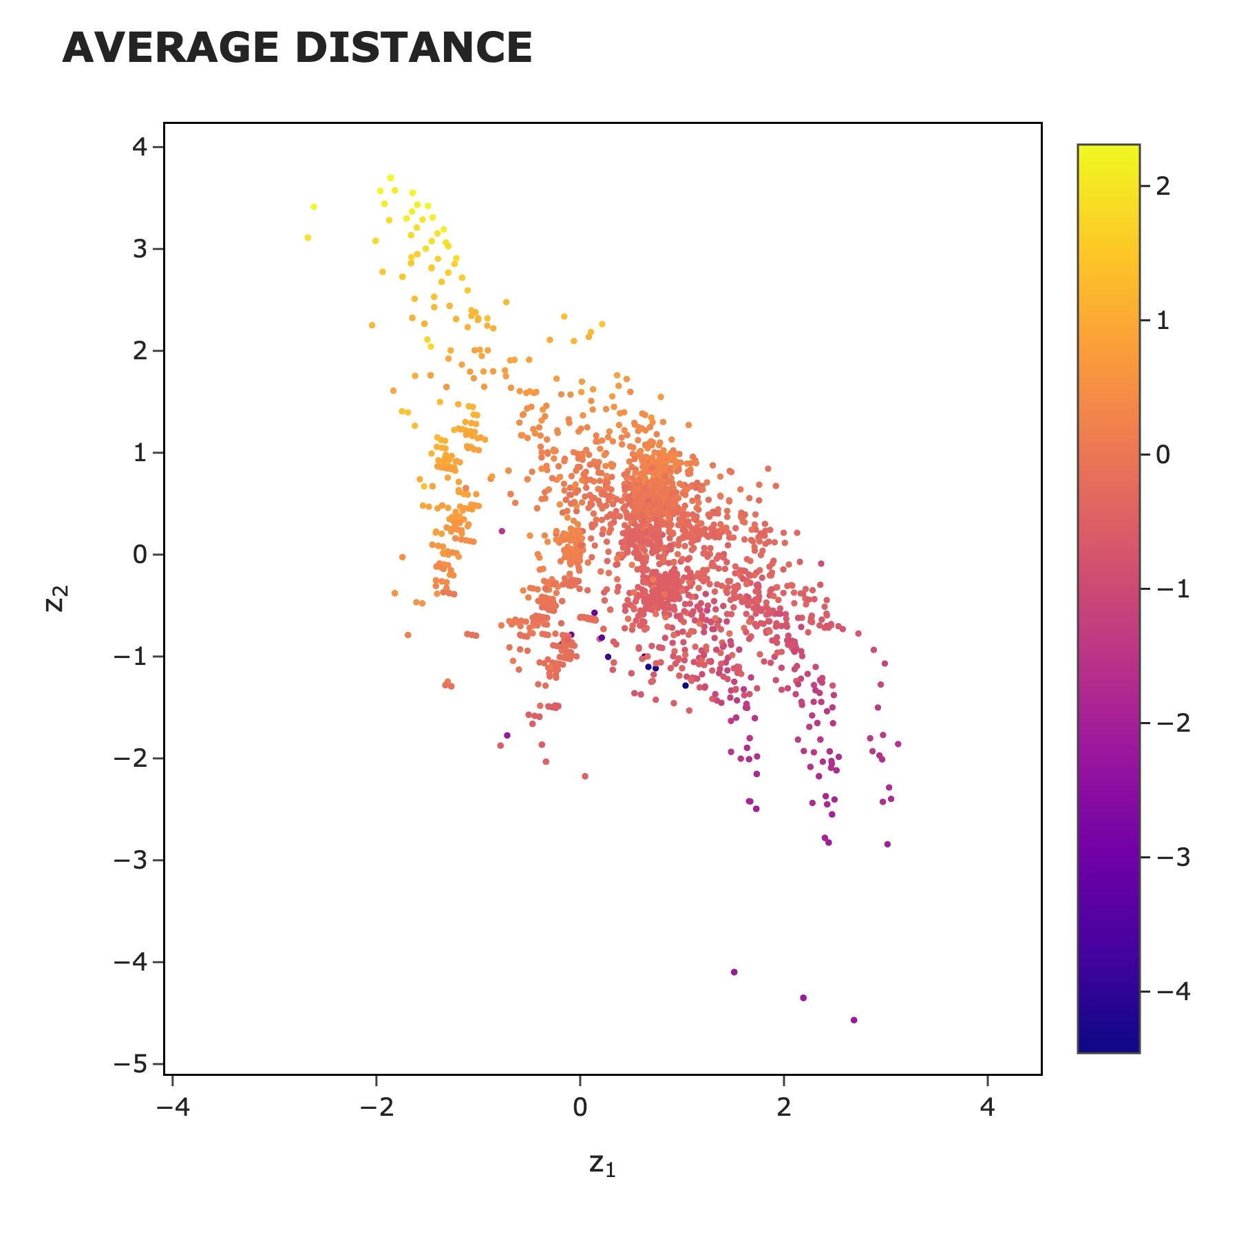
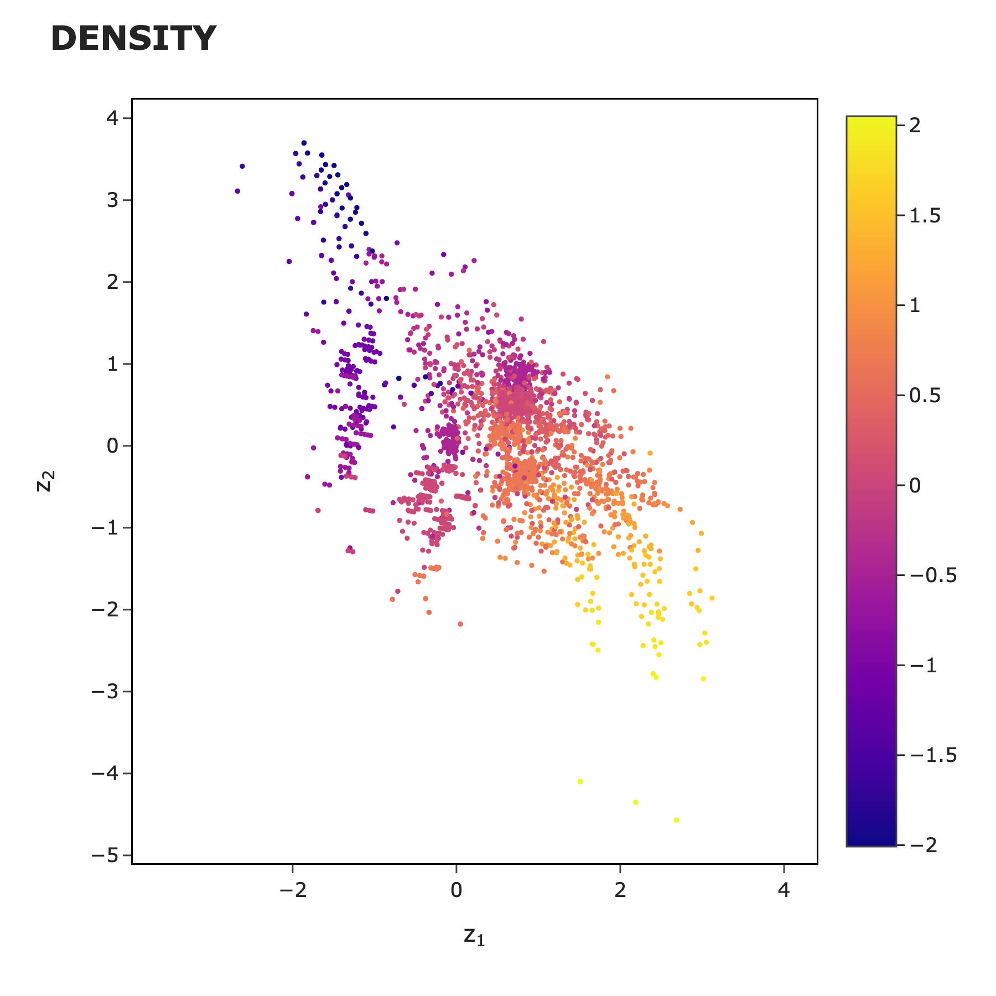
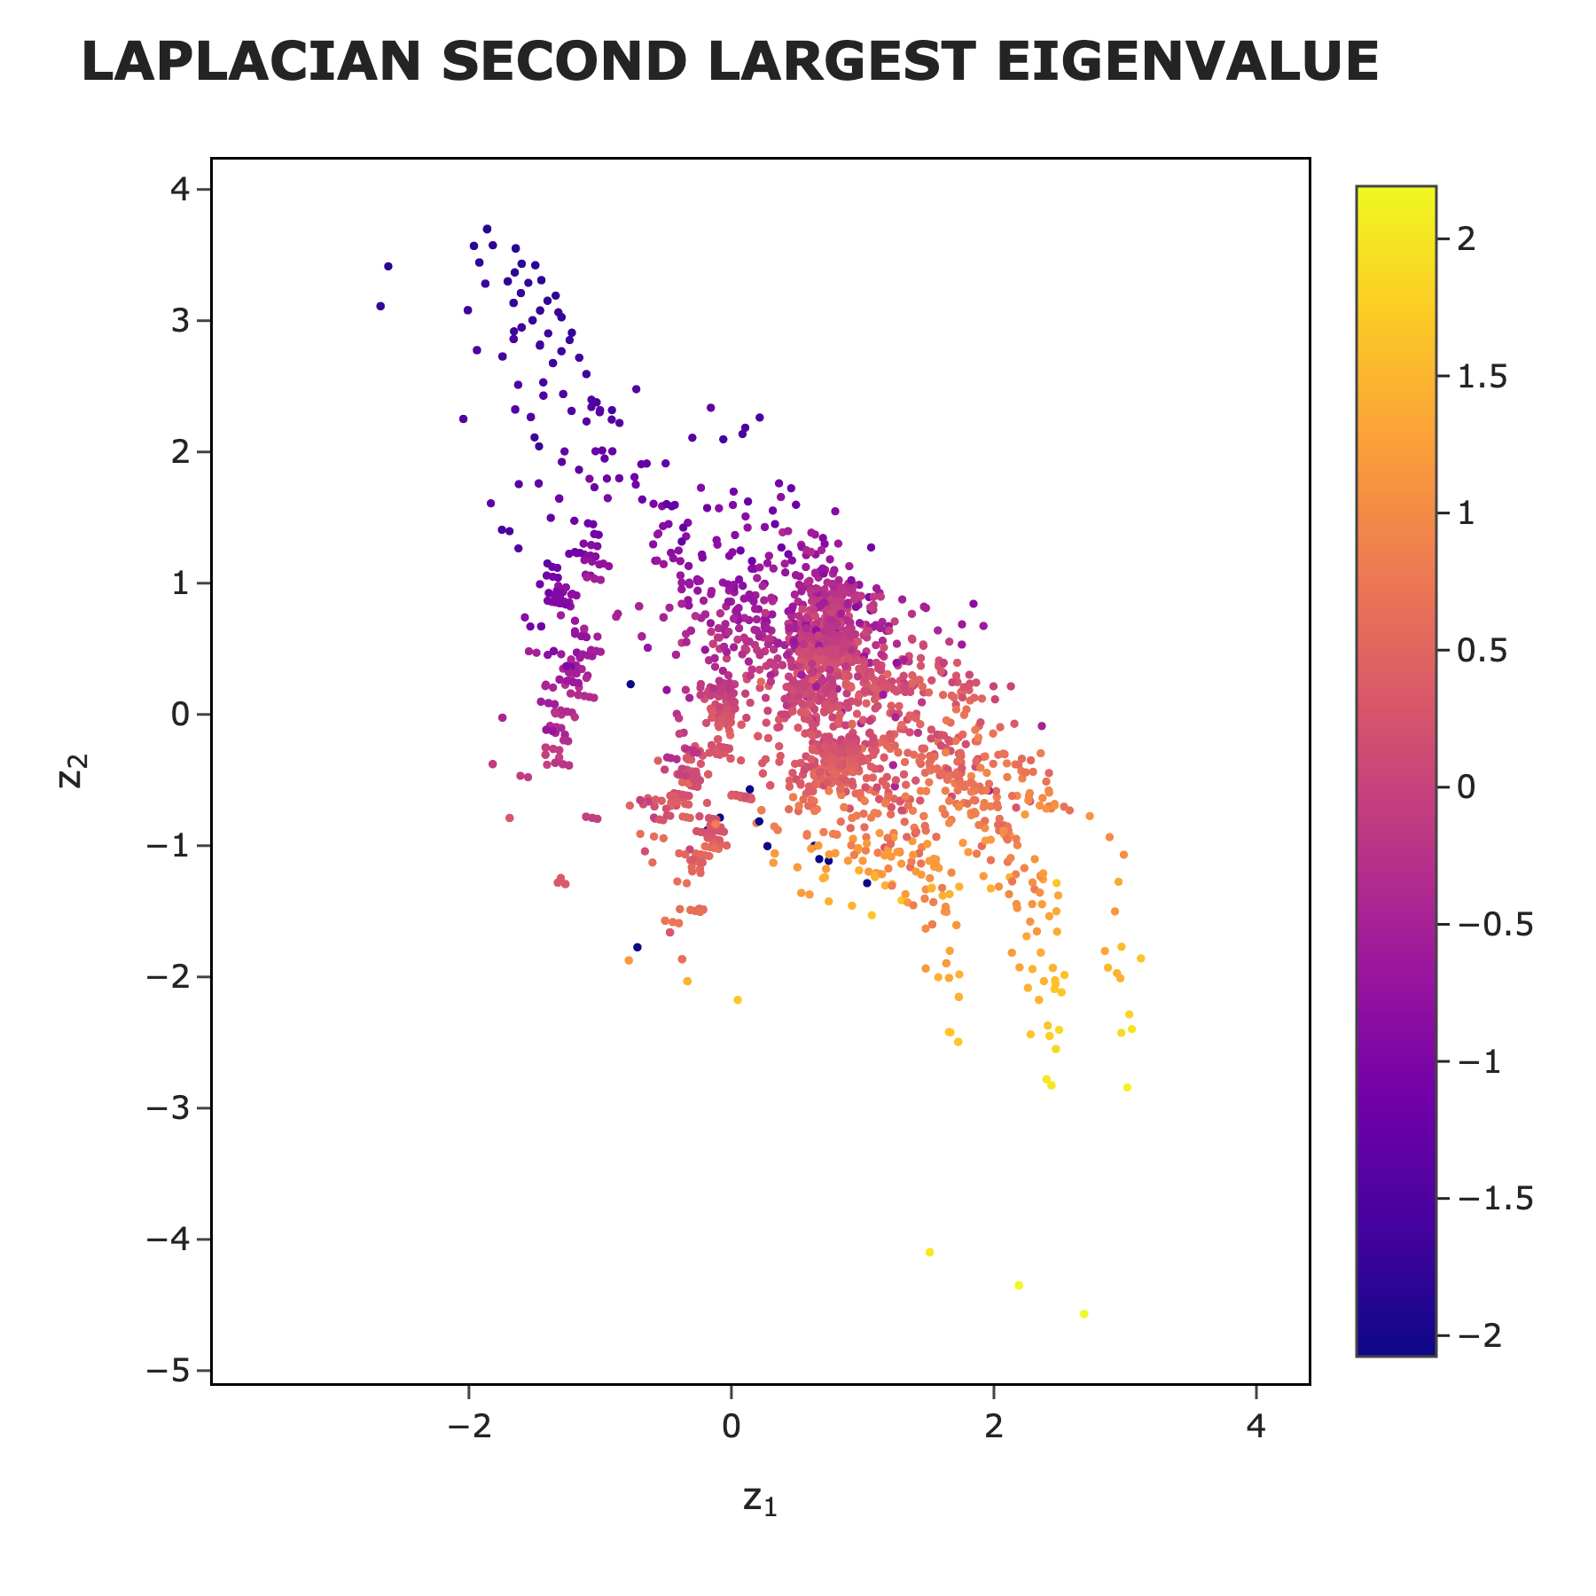
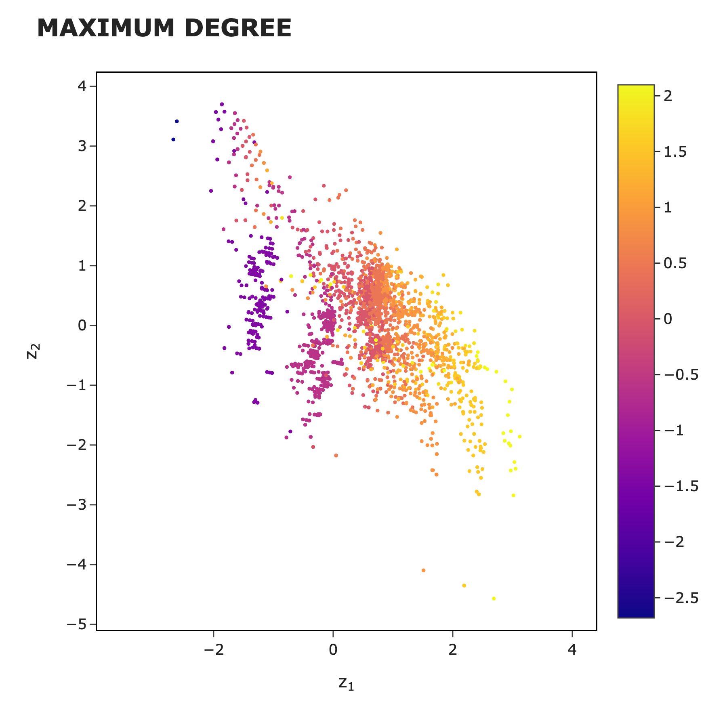
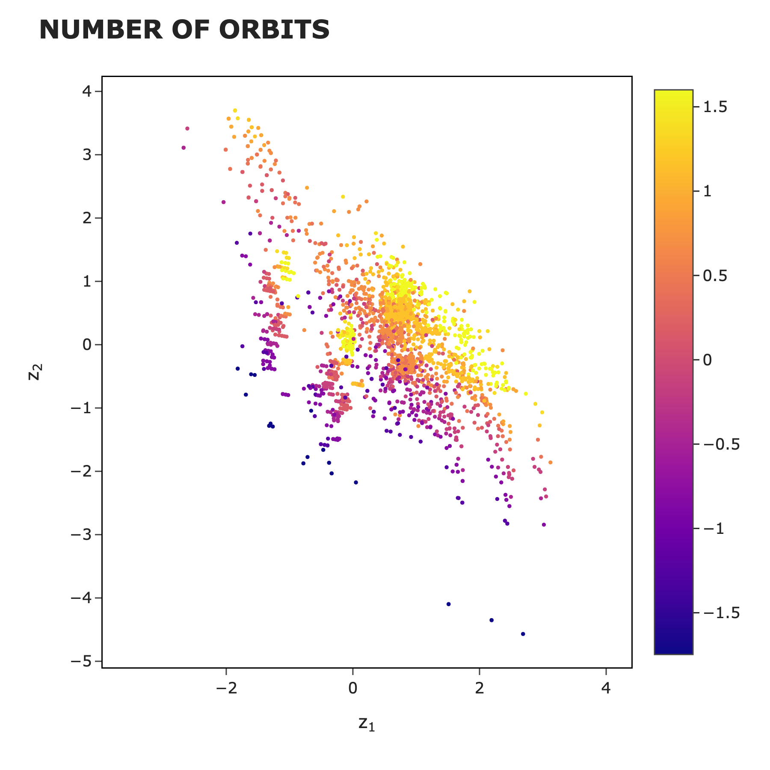
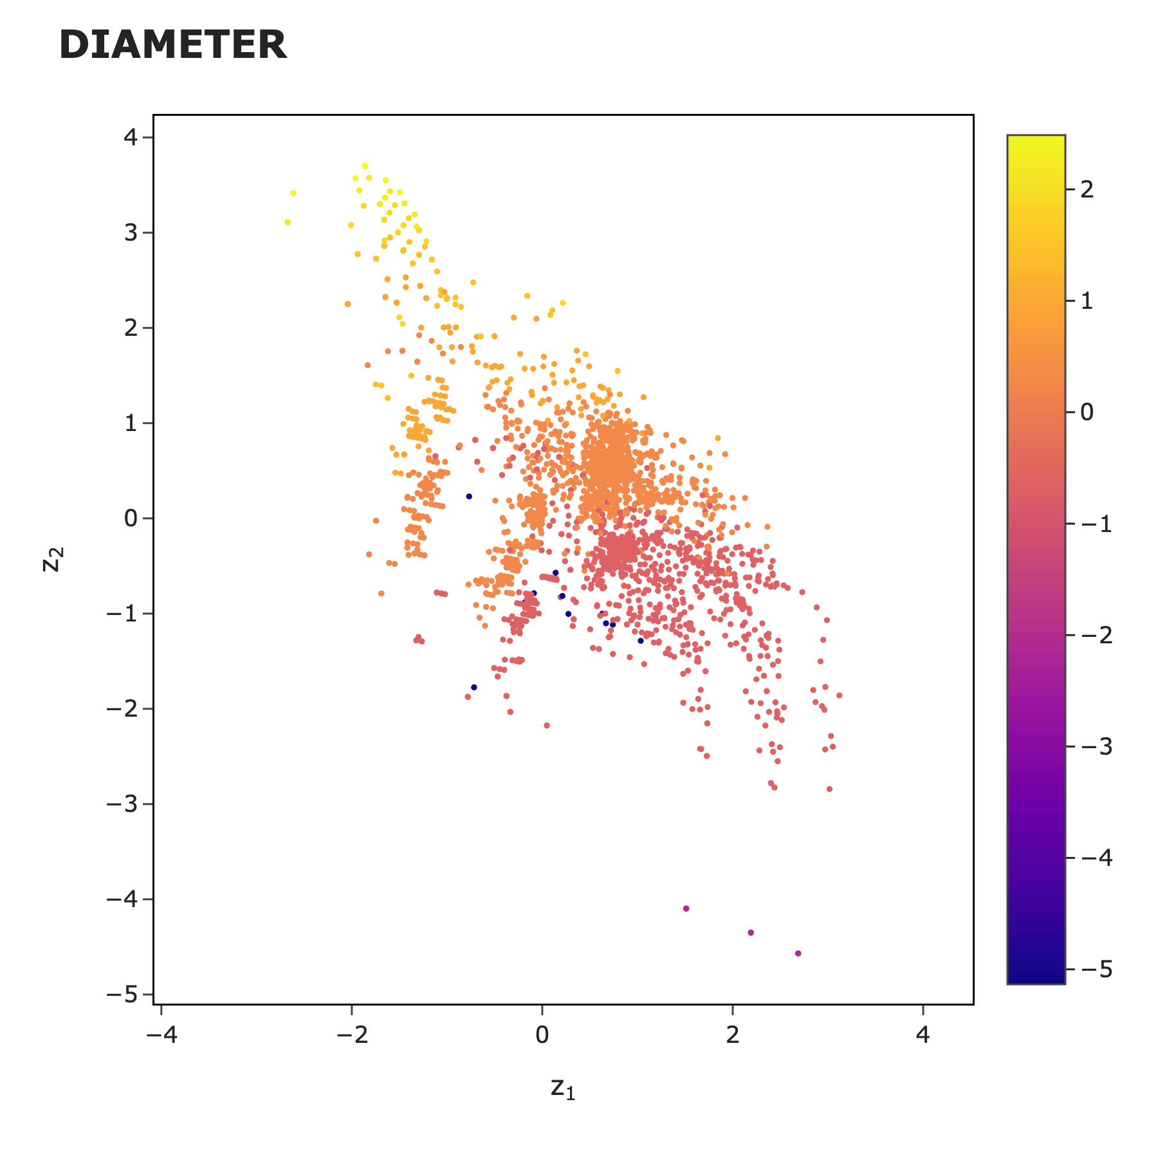
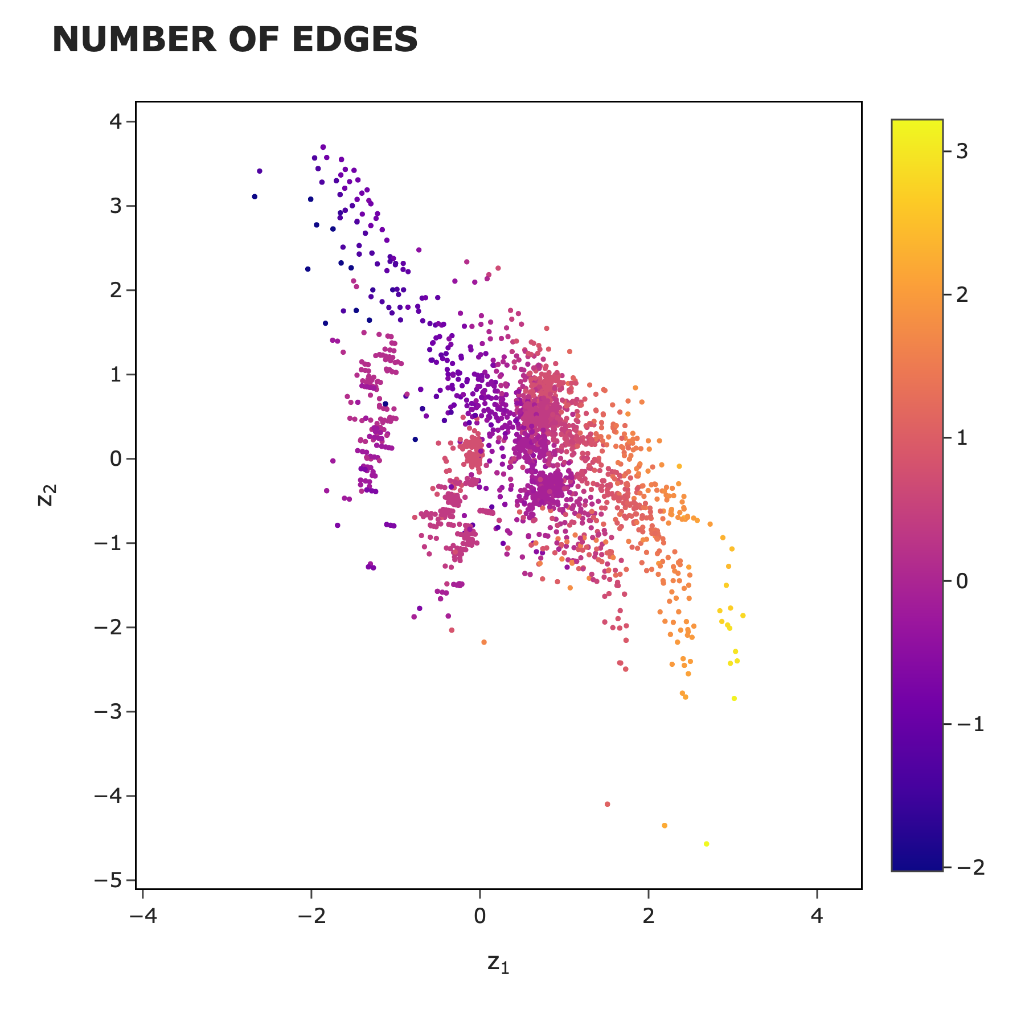
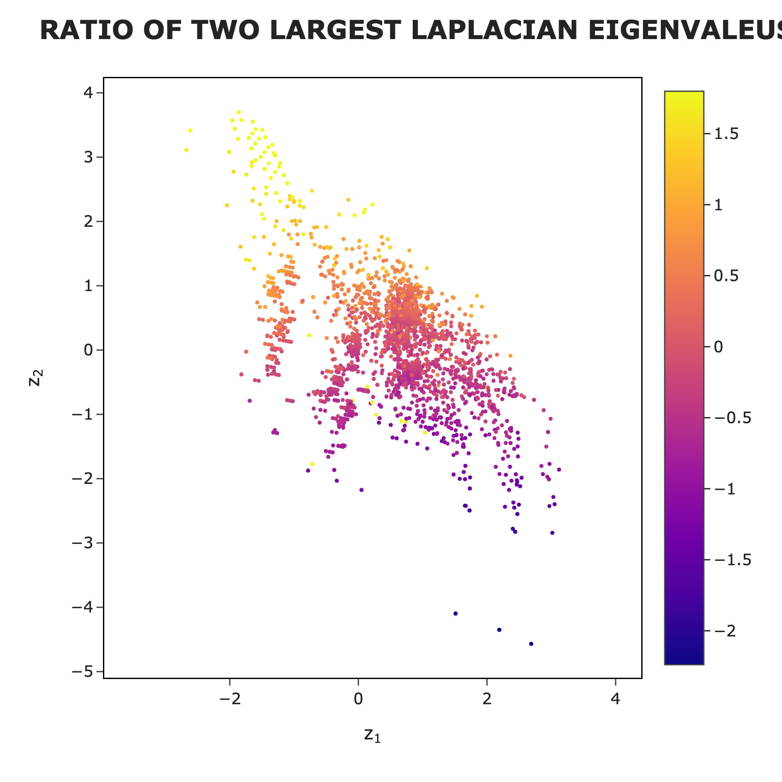
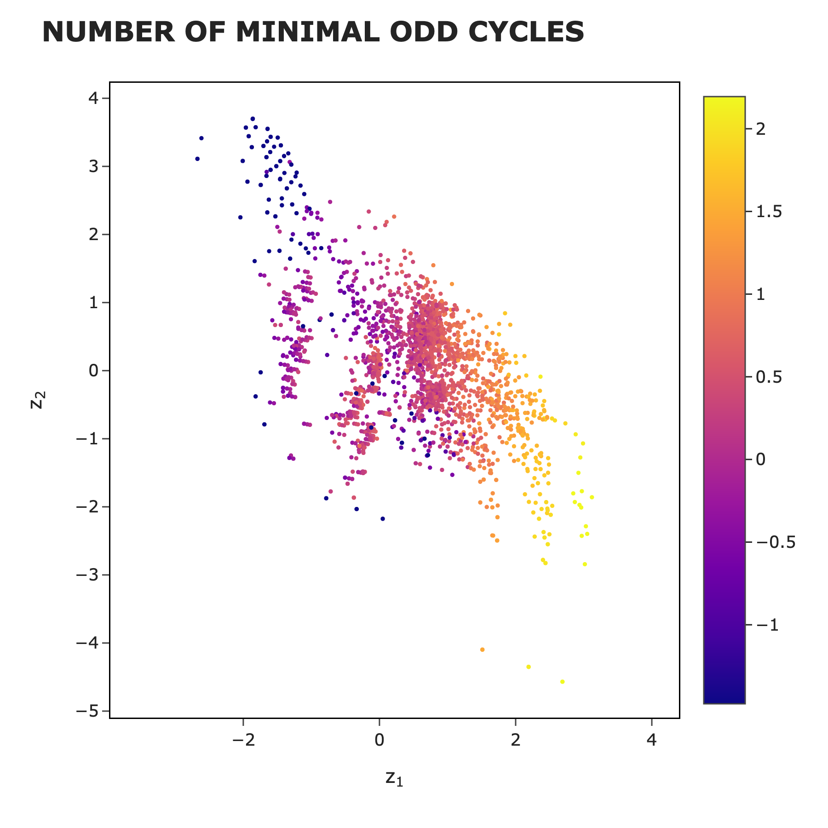
Features

Slide 21
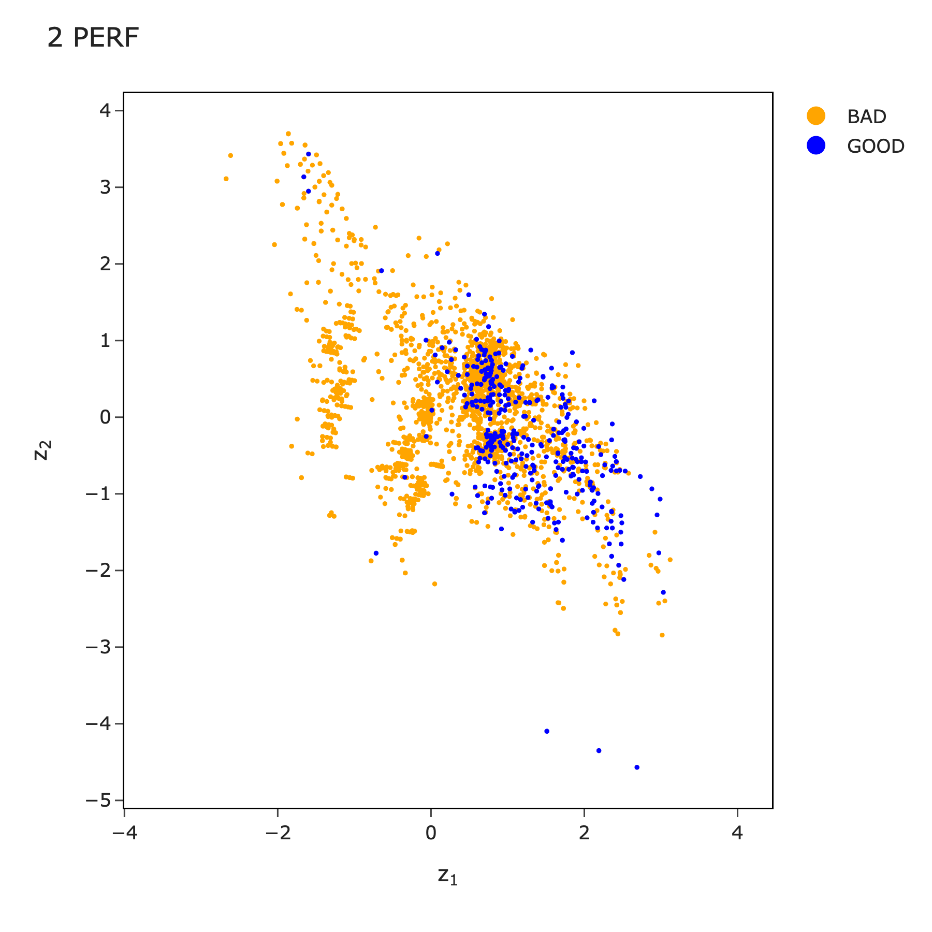

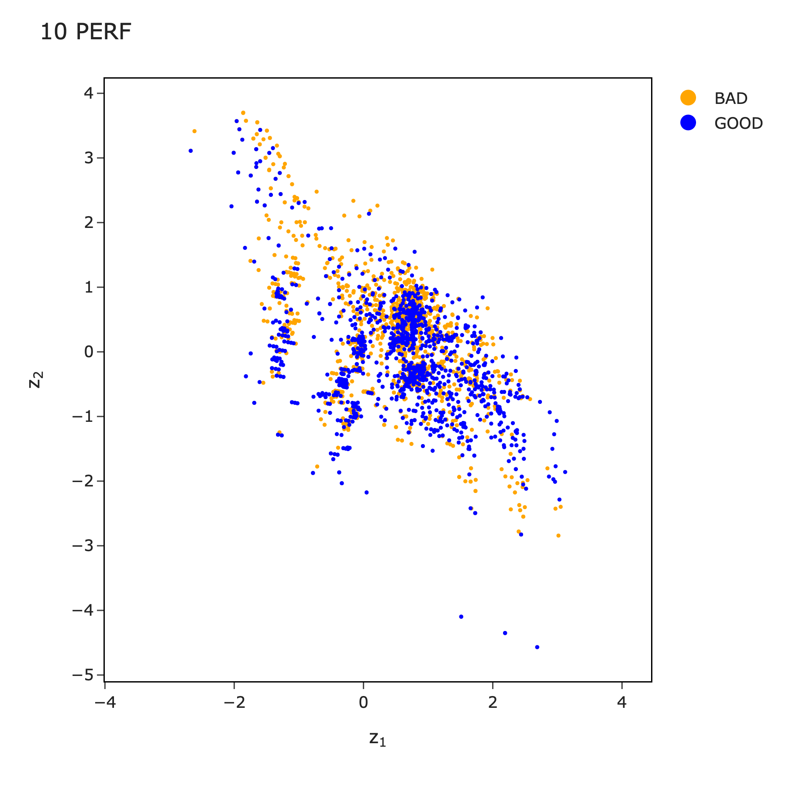
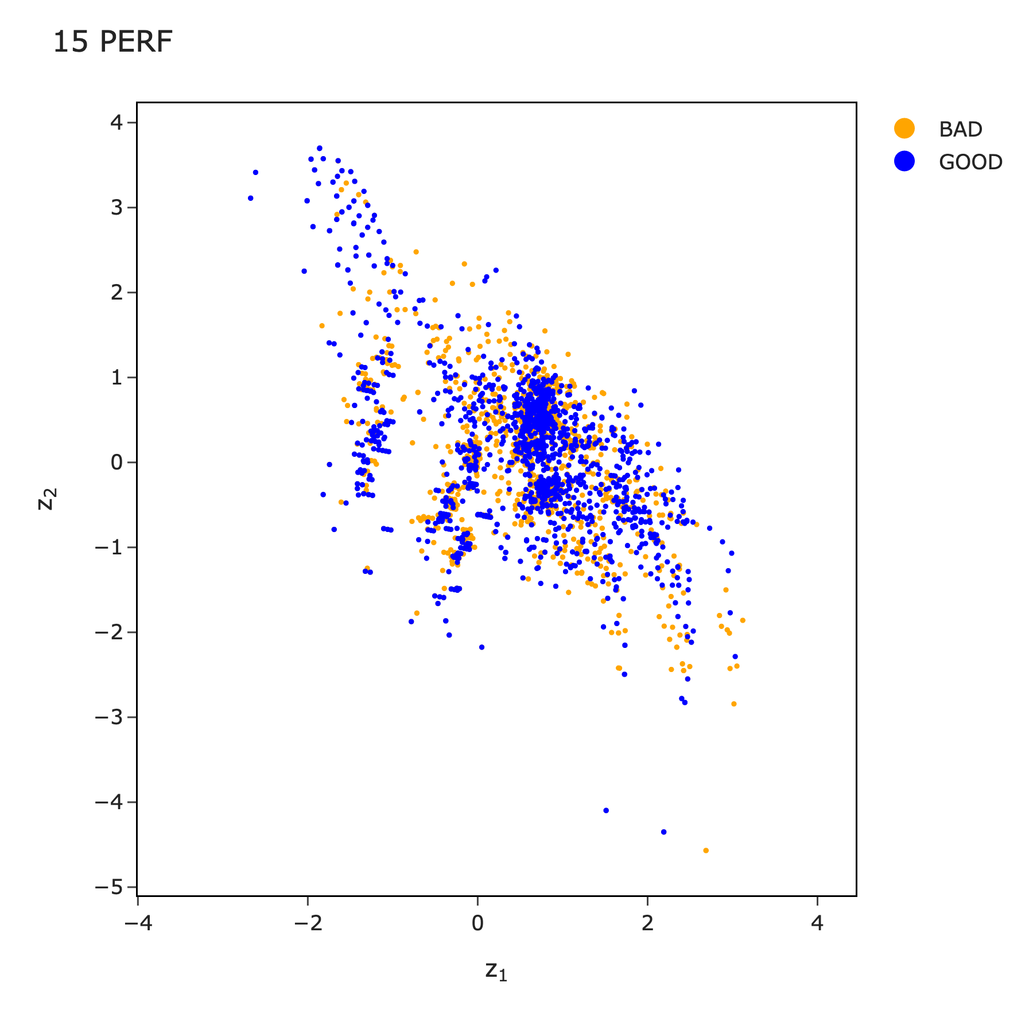
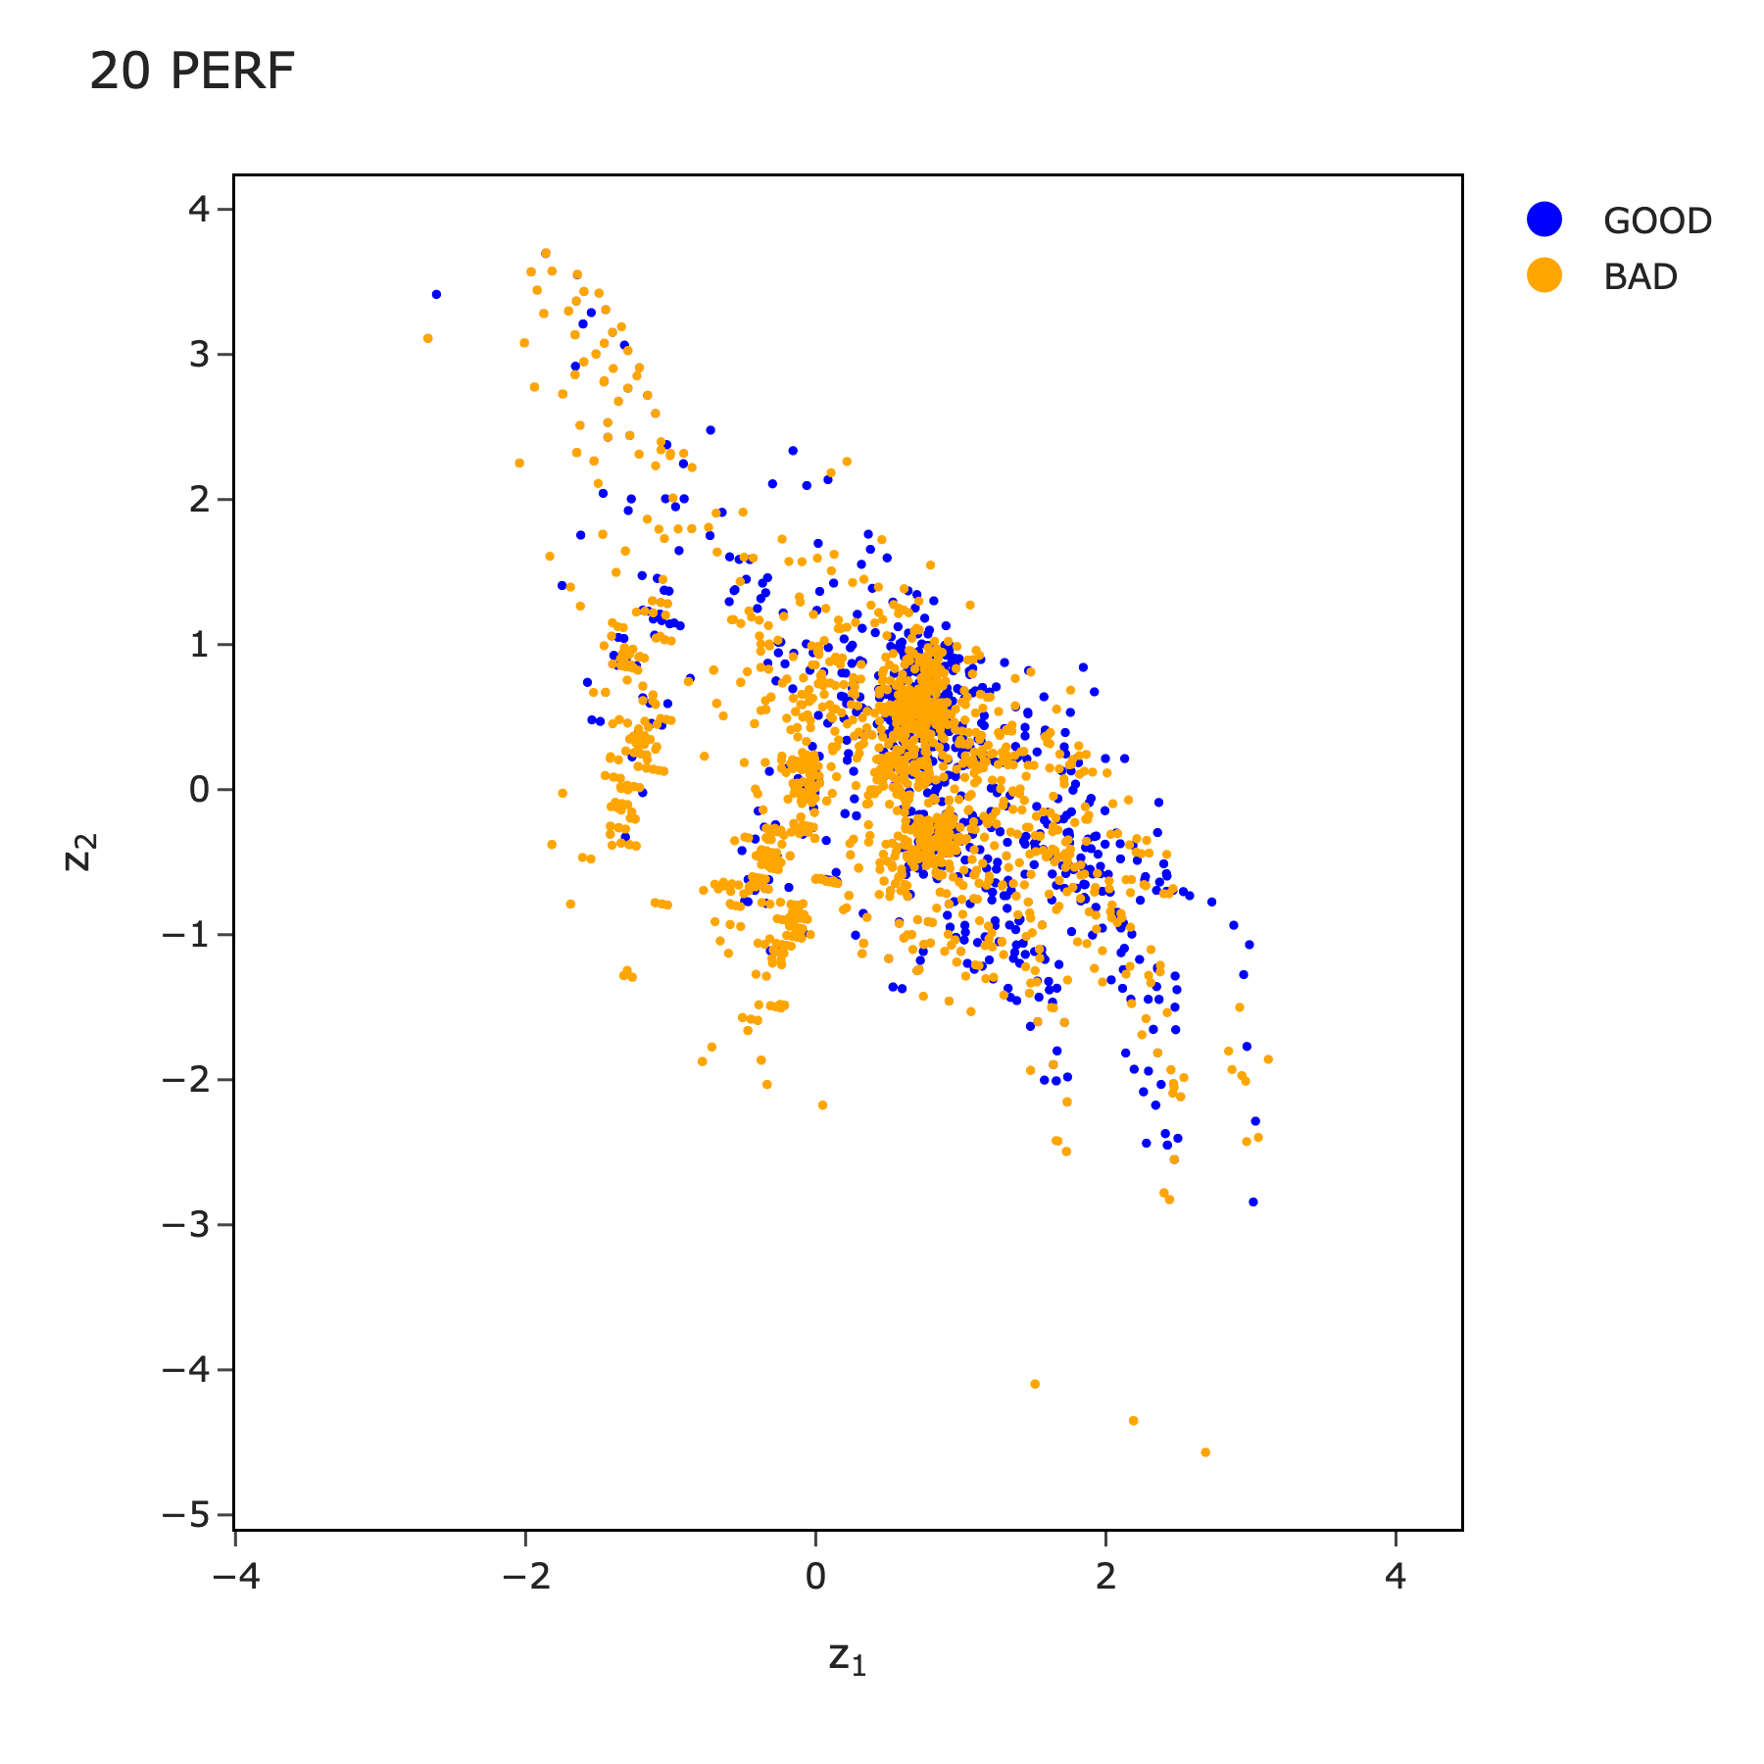
performance

Slide 22
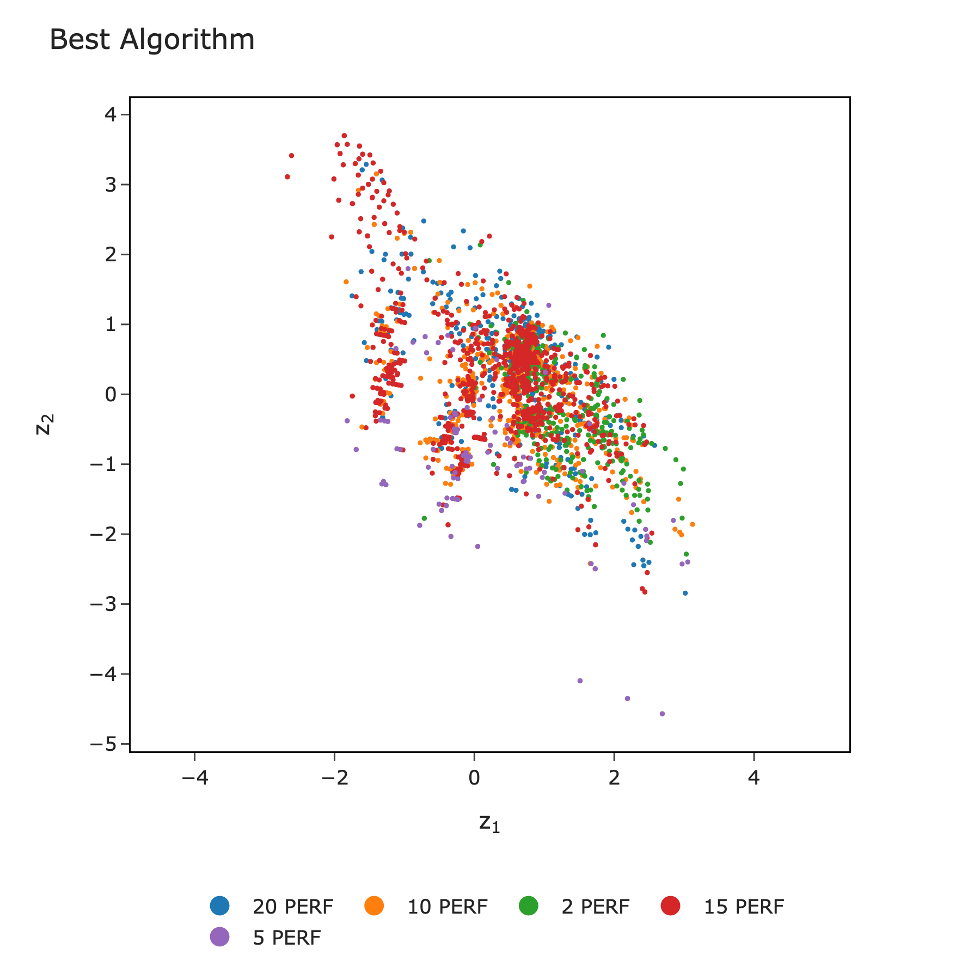
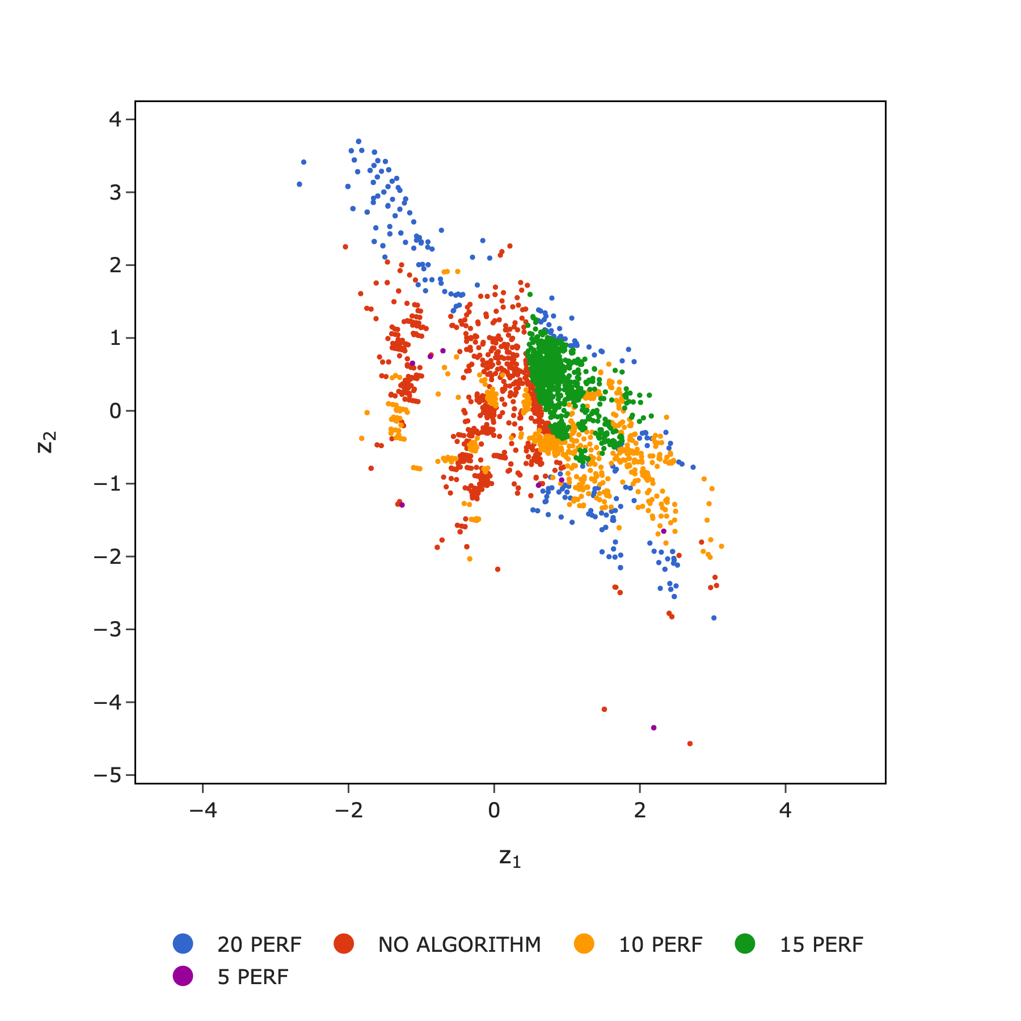
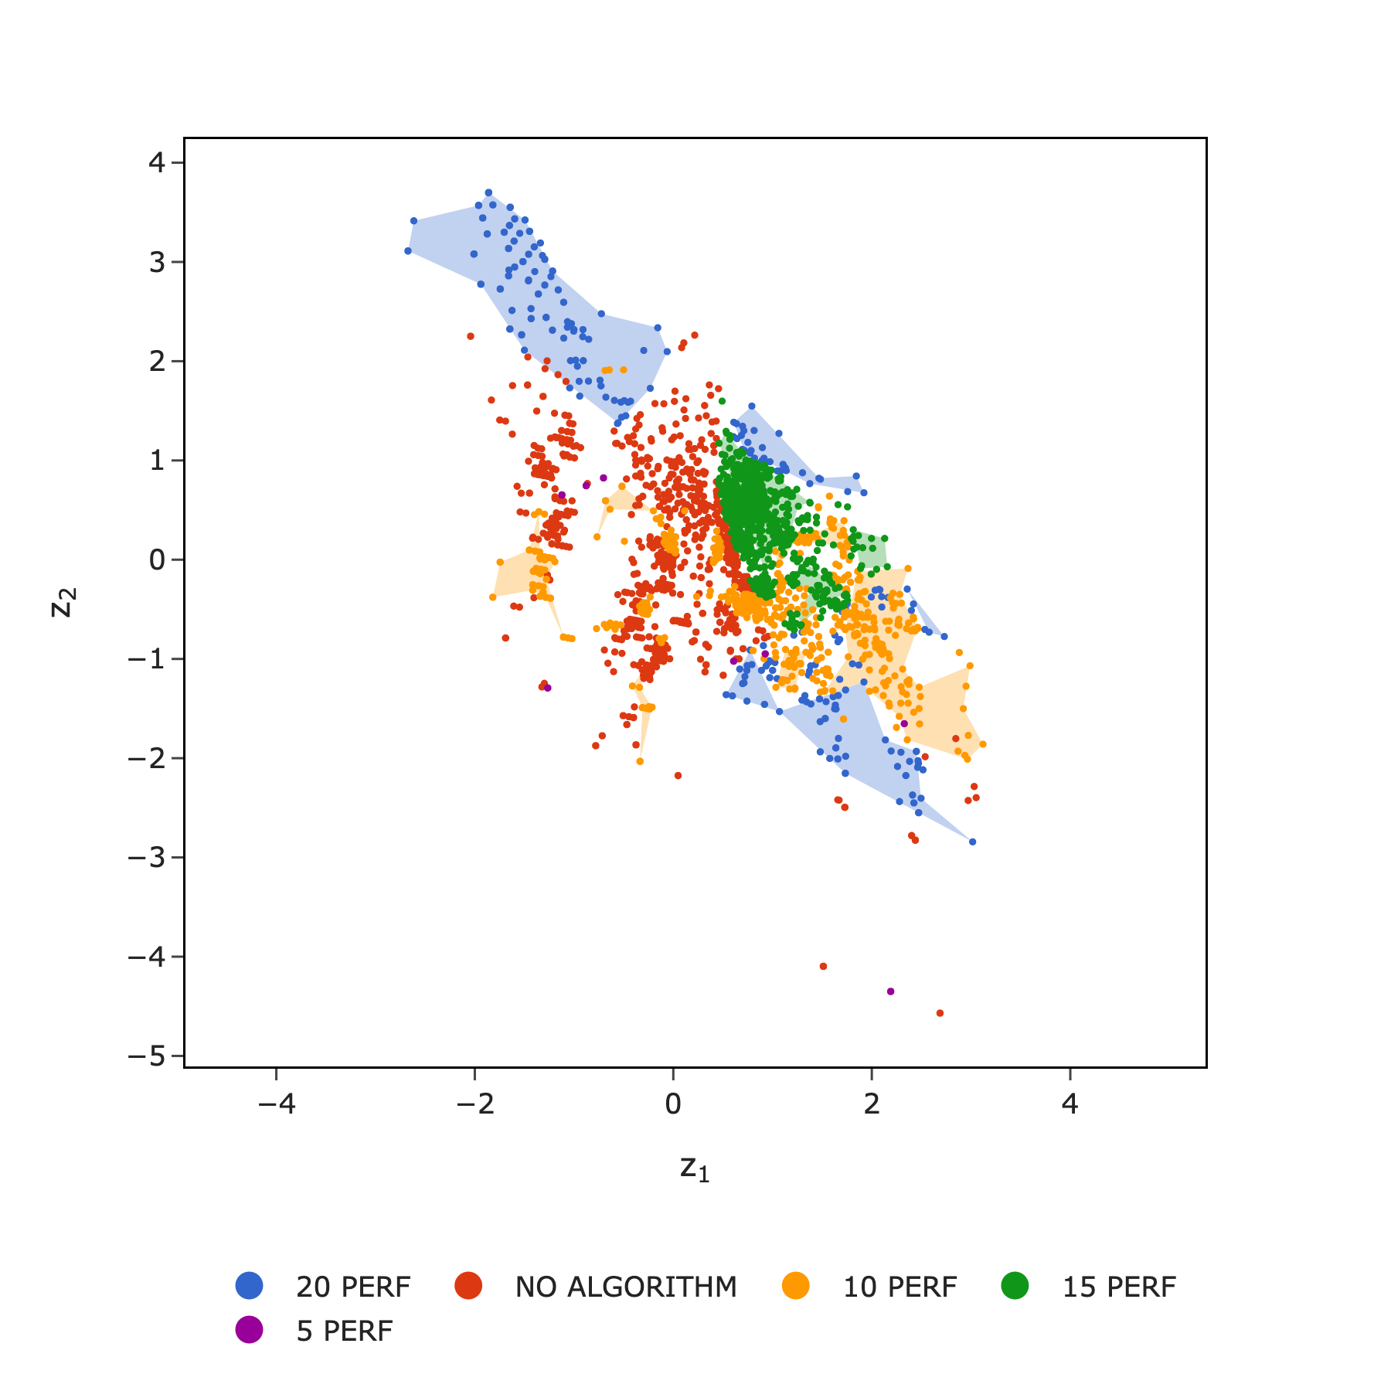
MATILDA SVM

Slide 23
CONCLUSIONS AND OTHER WORK
ISA provides critical insights into QAOA performance.
Our design decisions indicate that a tailored approach yields better performance
More diverse instances need to be studied.
Can we use ISA to answer other questions?
What parameter setting approach should we use?
What classical optimizer to use?
What ansatz should we use? Beyond QAOA…

Slide 24
References
[1] E. Farhi, J. Goldstone, S. Gutmann. arXiv:1411.4028 (2014)
[2] V. Katial, K.A. Smith-Miles, C.D. Hill, arXiv:2401.08142 (2024)
[3] K. A. Smith-Miles, Mario Andrés Muñoz, ACM Computing Surveys Volume 55 Issue 12 (2023)

